Slide 1

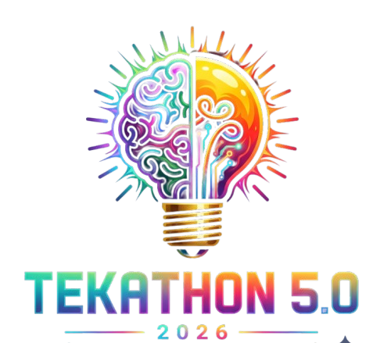

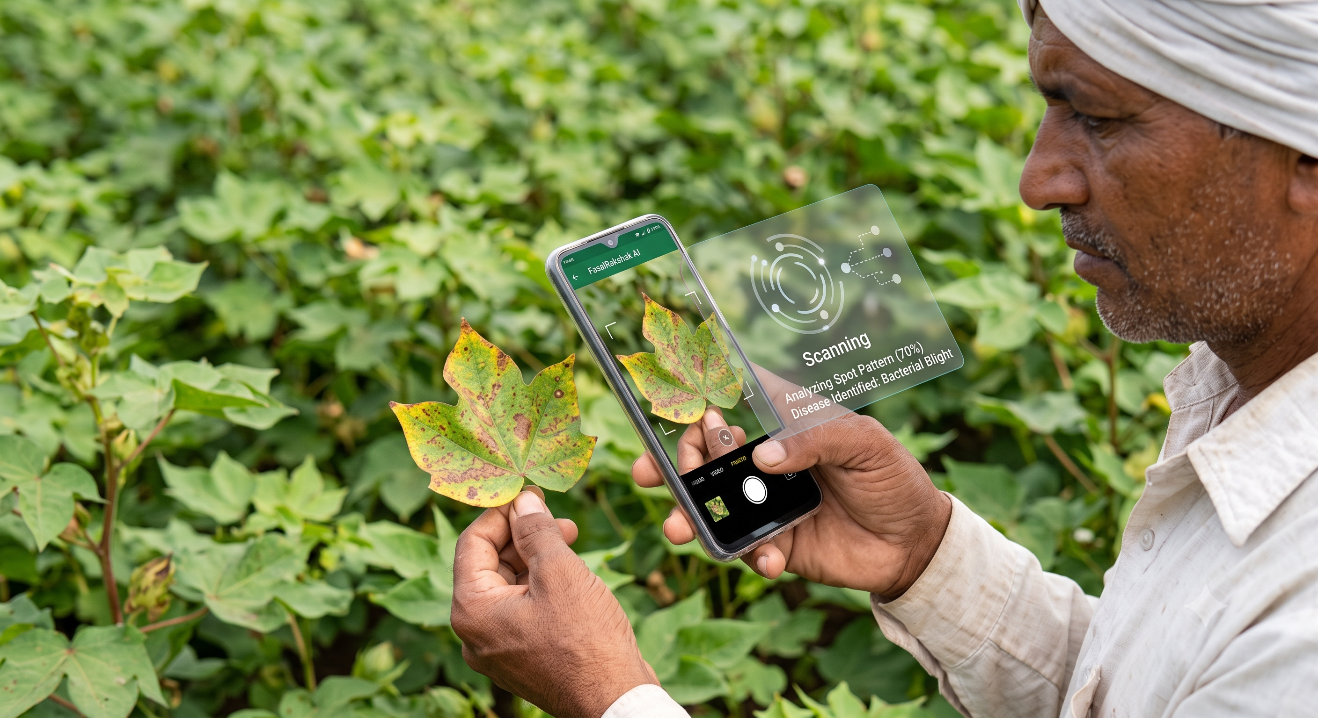
TEKATHON-5.0- 2026
Problem Statement ID – SIH26131
Problem Statement Title – Early Detection &
Management of Crop Diseases and Pest Infestations
Theme – Agriculture, FoodTech & Rural Development
PS Category – Software
Team Name (Registered on portal)

Slide 2
FasalRakshak AI | Leaf photo → diagnosis → village outbreak map
PROPOSED SOLUTION
Leaf photo → AI diagnosis in seconds
Vision fused with weather, soil & pest history
IPM-first treatment plan, multilingual
Works fully offline on-device
HOW IT SOLVES THE PROBLEM
Today: damage spotted only after it spreads
Officers cannot reach every field in time
Diagnosis delay: days → seconds
Curbs excess & wrong pesticide use
INNOVATION & UNIQUENESS
Not photo-only: context-aware risk score
Offline-first for low-connectivity villages
Every scan feeds a live village hotspot map
Individual scans → regional early warning
OUR TECHNICAL EDGE
Context fusion + 100% offline on-device + crowd-sourced village hotspot map
Photo-only diagnosis apps deliver none of these three.

Slide 3
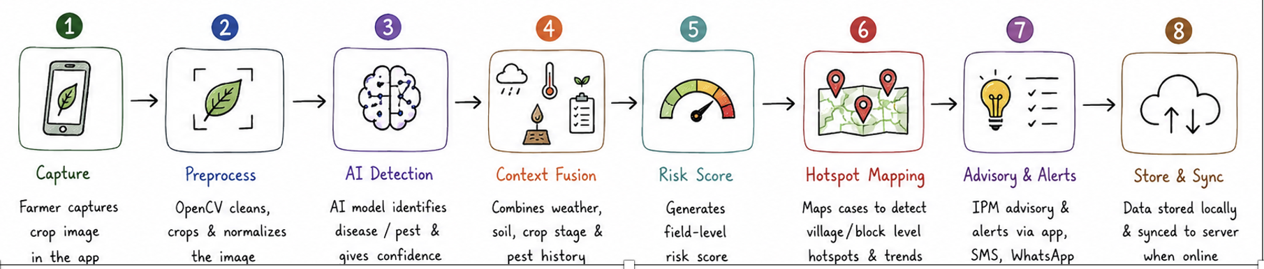
TECHNICAL APPROACH
TECH STACK Flutter (offline-first app) · Python + FastAPI · TensorFlow Lite on-device CNN (MobileNetV3 transfer learning) · OpenCV · OpenWeatherMap API · PostGIS + Leaflet · PostgreSQL
1 Capture & Preprocess
OpenCV crop, background removal, lighting normalisation
2 AI Disease / Pest ID
CNN on PlantVillage — 54,000+ images, 38 classes, 14 crops + local images
3 Contextual Risk Fusion
Weather + crop stage + soil + pest history → single risk score
6 Alerts & Officer Dashboard
SMS / app alert to nearby farmers; severity-ranked officer queue
5 Advisory & Treatment
Localised, multilingual, IPM-first plan — least-toxic option first
4 Hotspot Mapping
Cases plotted at village / block level; clusters auto-flag outbreaks
Steps 1–3 run entirely on-device — no internet needed for a diagnosis

Slide 4
FEASIBILITY AND VIABILITY
Zero licence cost
Free open-source stack + public PlantVillage dataset — no GPU cluster
~10M farmers/yr
Plantix already runs this solution category at scale in India
Proven method
Transfer learning for leaf-disease ID is well-documented
RISKS & MITIGATION
Risk / Challenge | Mitigation
Indian crop strains differ from PlantVillage source images | Fine-tune with local images via KVKs & agricultural universities
Patchy or no rural connectivity | Offline-first TFLite model on-device + SMS / IVR fallback
Low farmer adoption of a new app | Integrate with WhatsApp — no new app habit required
Pesticide misuse if a diagnosis is wrong | Low-confidence cases routed to human expert; IPM-first by default

Slide 5
IMPACT AND BENEFITS
10–30%
of India's crop yield lost every year to pests, diseases & weeds
US$12 Bn
estimated annual value of that loss in Indian agriculture
90%+
AI diagnostic accuracy vs 60–70% for manual expert diagnosis
Farmers: diagnosis in seconds, not days | Extension officers: live outbreak map instead of blind field visits
SOCIAL
Protects farmer income & food security
Disease caught before it wipes out a harvest
ECONOMIC
Cuts unnecessary pesticide spend
Reduces yield loss per acre
ENVIRONMENTAL
Less blanket pesticide spraying
Lower chemical residue & ecological harm

Slide 6
RESEARCH AND REFERENCES
Source | What it evidences
Smart India Hackathon 2026 — Problem Statement SIH26131, Govt. of Maharashtra (sih.gov.in) | Official problem definition and scope
PlantVillage Dataset — Penn State University | Training corpus for the on-device disease / pest classifier
International Pest Control Magazine — crop protection in India | India's annual crop loss to pests and disease (Slide 5)
GSMA Mobile for Development — Plantix case study | At-scale precedent and AI vs manual accuracy (Slides 4–5)
OPEN DATA & STANDARDS USED
PlantVillage open dataset · ICAR / KVK Integrated Pest Management advisories · OpenWeatherMap API · PostGIS geospatial standards
http://ieeexplore.ieee.org/document/10458943/
http://ieeexplore.ieee.org/document/10883358/
http://arxiv.org/abs/1604.03169
https://link.springer.com/article/10.1186/s13007-023-01122-x
https://www.nature.com/articles/s41598-025-18613-7
https://academic.oup.com/jipm/article/12/1/16/6245490
https://pmc.ncbi.nlm.nih.gov/articles/PMC1647291/

